Slide 1
Chapter 4:
Intellectual Property

Slide 2
Google Books
Google announced plan to scan millions of books held by several huge libraries, creating searchable database of all words
If public domain book, system returns PDF
If under copyright, user can see a few sentences; system provides links to libraries and online booksellers
Authors Guild and publishers sued Google for copyright infringement (copying books for commercial reasons)
Out-of-court settlement reached
1-<number>

Slide 3
Benefits of Proposed Settlement
Google would pay $125 million to resolve legal claims of authors and publishers and establish Book Rights Registry
Readers would have much easier access to out-of-print books at U.S. public libraries and university libraries
University libraries could purchase subscriptions giving their students access to collections of some of world’s greatest libraries
Authors and publishers would receive payments earned from online access of their books, plus share of advertising revenues
1-<number>

Slide 4
Criticisms of Proposed Settlement
Google should have gone to court
  Google had a good case that its use was a fair use, based on precedent of Kelly v. Arriba Soft
  If Google had been found not guilty of copyright infringement, it could have given public access to books at lower rates
Agreement gives Google a virtual monopoly over orphaned works
Potential chilling effect of Google tracking the pages that people are viewing
1-<number>

Slide 5
Court Rejects Proposed Settlement
March 2011: U.S. District Court for Southern District of New York rejected proposed settlement
Judge ruled agreement would have:
  Given Google significant advantage over competitors
  Rewarded Google for “wholesale copying of copyrighted words without permission”
  Given Google liberal rights over orphaned works
1-<number>

Slide 6
4.5 New Restrictions on Use
1-<number>

Slide 7
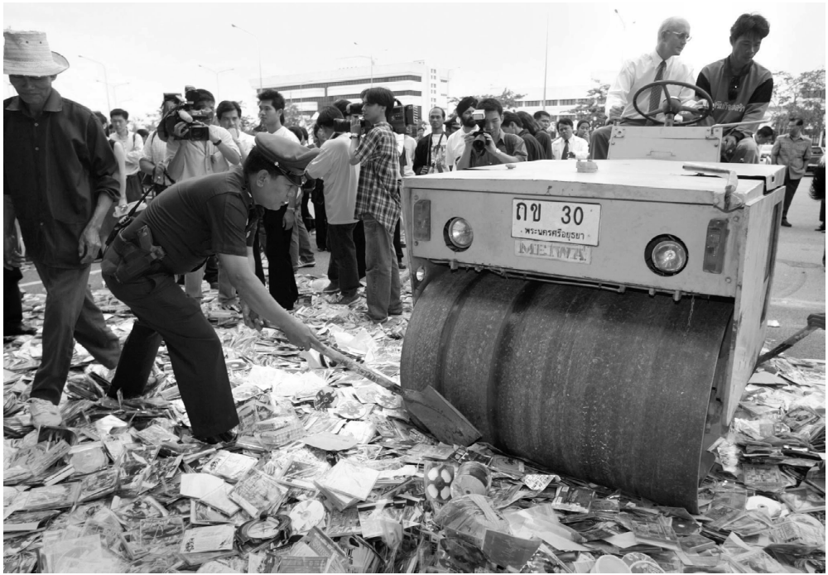
Counterfeit CDs = Lost Profits
© Reuters/CORBIS
1-<number>

Slide 8
Digital Millennium Copyright Act
First big revision of copyright law since 1976
Brought U.S. into compliance with Europe
Extended length of copyright
Extended copyright protection to music broadcast over Internet
Made it illegal for anyone to
  Circumvent encryption schemes placed on digital media
  Circumvent copy controls, even for fair use purposes
1-<number>

Slide 9
Digital Rights Management
Actions owners of intellectual property in digital form take to protect their rights
Approaches
  Encrypt digital content
  Mark digital content so devices can recognize content as copy-protected
1-<number>

Slide 10
Secure Digital Music Initiative
Goals
  Create copy-protected CDs
  Secure digital music downloads
Consortium of 200 companies developed “digital watermarking” scheme
Failed
  Internet copying became huge before SDMI ready
  Some SDMI sponsors were electronics companies
  Digital watermarking encryption cracked
1-<number>

Slide 11
Sony BMG Music Entertainment Rootkit
Millions of audio CDs shipped with Extended Copy Protection, a DRM system
Prevented users from
  Ripping audio tracks into MP3 format
  Making more than 3 backup copies
Relied upon Windows “rootkit” that hid files and processes; usually only hackers use rootkits
Huge public outcry once secret uncovered
Sony BMG stopped production and compensated consumers
1-<number>

Slide 12
Encrypting DVDs
Contents of DVDs encrypted using Content Scramble System (CSS)
Need decryption keys to view a DVD
Jon Johansen wrote a decryption program for Linux
2600 Magazine published the code
Motion picture studios sued 2600 Magazine and won
Johansen tried in Norway and found not guilty
1-<number>

Slide 13
Foiling HD-DVD Encryption
Hardware, software, and entertainment companies created Advanced Access Content System to encrypt HD-DVDs
Encryption key posted on Digg.com
AACS leaned on Digg.com to censor postings containing key
Digg users fought back
AACS “expired” the key and issued a new one
A month later, a Digg user posted the new key
1-<number>

Slide 14
Criticisms of Digital Rights Management
Any technological “fix” is bound to fail
DRM undermines fair use
DRM could reduce competition
Some schemes make anonymous access impossible
1-<number>

Slide 15
Online Music Stores Employed Digital Rights Management
When iTunes Music Store opened, all music was protected with a DRM scheme called FairPlay
FairPlay blocked users from freely exchanging purchased music
  Songs couldn’t be played on more than 5 different computers
  Songs couldn’t be copied onto CDs more than 7 times
Songs purchased from iTunes Store wouldn’t play on non-Apple devices
DRM-protected music purchased from other online retailers couldn’t be played on iPod
1-<number>

Slide 16
Online Music Stores Drop Digital Rights Management
Consumers complained about restrictions associated with DRM
European governments put pressure on Apple to license FairPlay or stop using DRM
Amazon reached an agreement with all four major music labels to sell DRM-free music
Apple followed suit in 2009
1-<number>

Slide 17
Microsoft Xbox One
Microsoft announced cloud-based gaming experience for Xbox One (June 2013)
  User could play any game without disc in tray
  Automatic software updates of every Xbox One
Controversial features of licensing arrangement
  Disc could be shared only once
  Second-hand market restricted
  Xbox consoles would have to check in every 24 hours
Microsoft backtracked
  No need to connect to Internet
  Freedom to lend, rent, buy, sell discs
  Disc must be in tray to play game
1-<number>

Slide 18
4.6 Peer-to-Peer Networks and Cyberlockers
1-<number>

